Slide 1
ETL process

Slide 2
Extract
CSV
SQL
API

Slide 3
5 normal forms
Atomic values and unique rows
Depend on entire key
Eliminate transitive dependencies
Eliminate multi-valued dependencies
Eliminate join dependencies

Slide 4
Transformation (Column values)
Columns | Previous format | New format
Phone Number | (555) 555-1234 | +15555551234
Product Name | Heller Shagamaw Frame - 2016 | Shagamaw Frame

Slide 5
Transformation (Removal of columns)
Table | Column | Alternative table | Alternative column | Deleted
Oreder_items | Item_id | - | - | Yes
Staffs | Street | Stores | Street | Yes
Order_items | List_price | Products | List_price | No
Orders | Store_id | Staffs | Store_id | No

Slide 6
Transformation (Datatypes)
Decimal(16,2)
Date(dd/mm/yyyy)

Slide 7
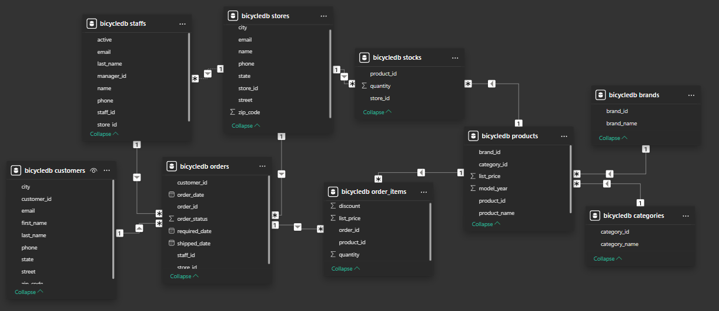
Load

Slide 8
Performance

